Slide 1



India GDP
View in Power BI
Last data refresh:
12/30/2022 1:22:33 PM UTC
Downloaded at:
12/30/2022 1:24:16 PM UTC

Slide 2
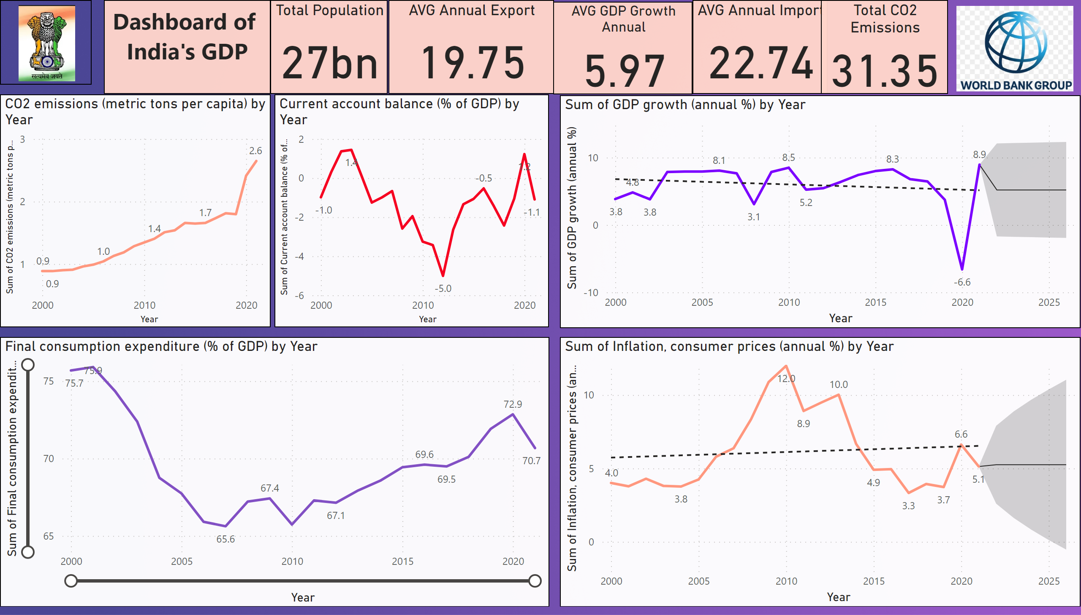
Dashboard
Notes:
AVG GDP Growth Annual
No alt text provided
AVG Annual Export
No alt text provided
AVG Annual Import
No alt text provided
Total Population
No alt text provided
textbox
No alt text provided
image
No alt text provided
Total CO2 Emissions
No alt text provided
Final consumption expenditure (% of GDP) by Year
No alt text provided
CO2 emissions (metric tons per capita) by Year
No alt text provided
Current account balance (% of GDP) by Year
No alt text provided
lineChart
No alt text provided
lineChart
No alt text provided
image
No alt text provided

Slide 3
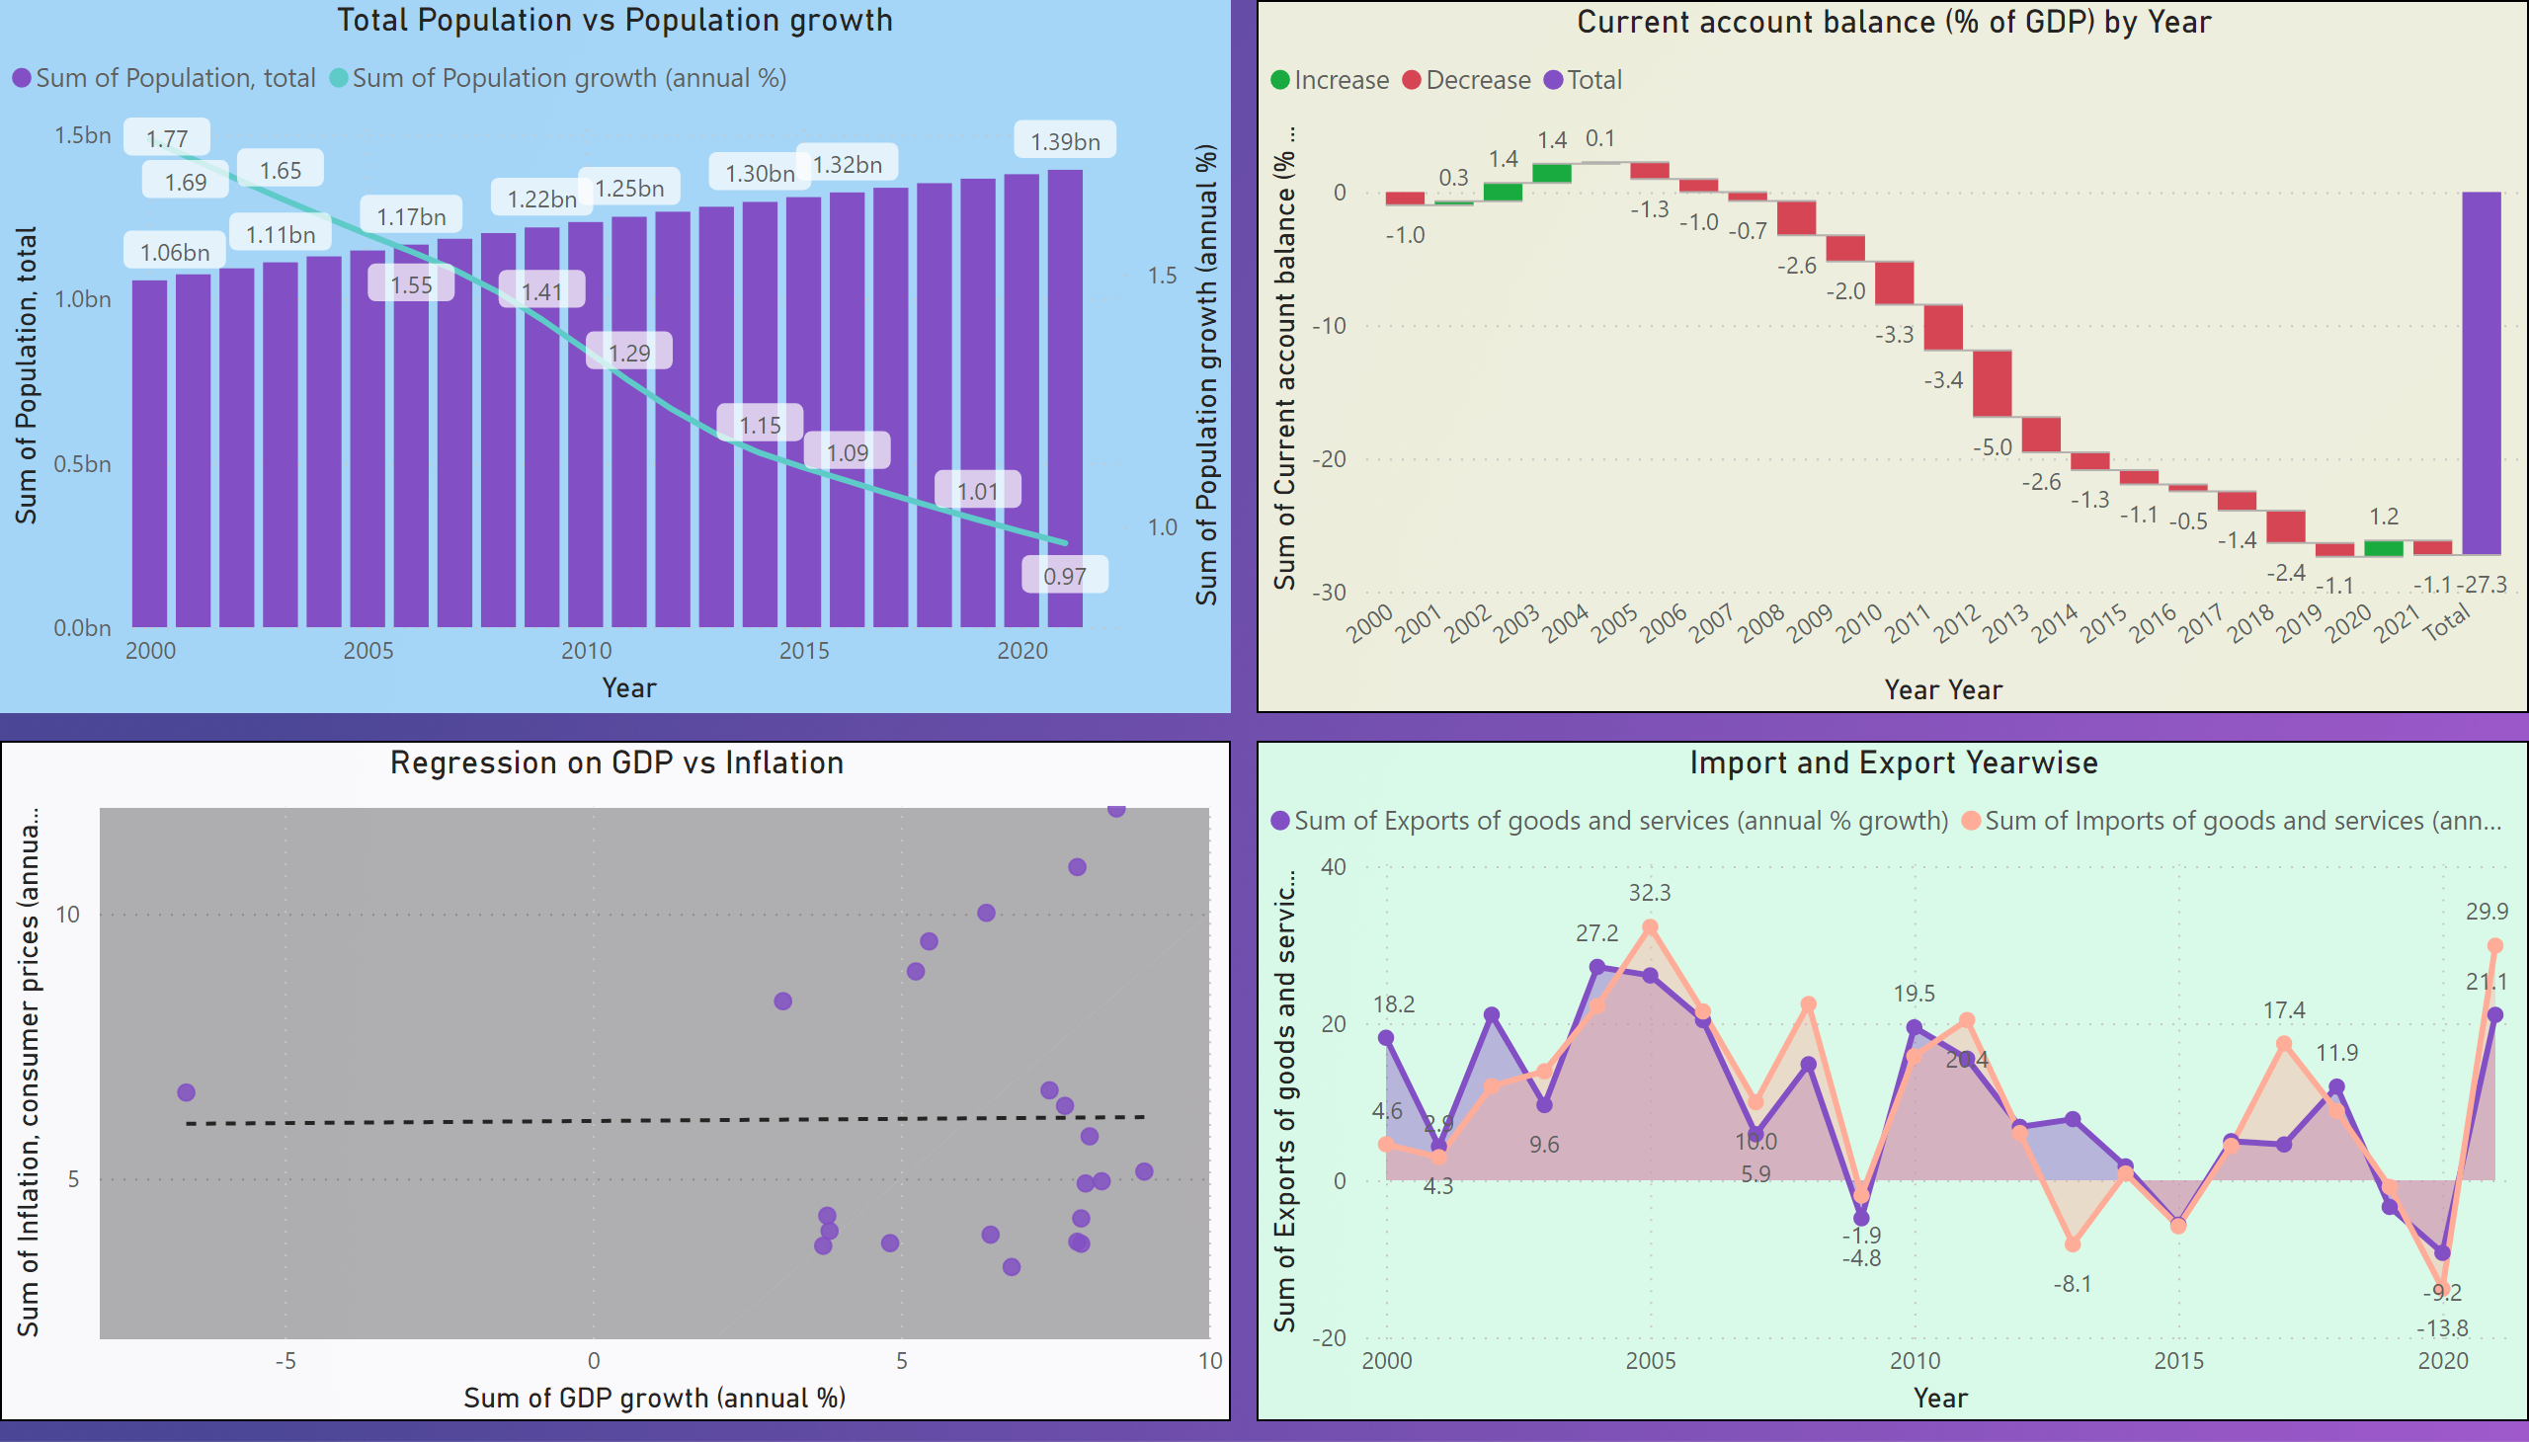
Dashboard 2
Notes:
Import and Export Yearwise
No alt text provided
Regression on GDP vs Inflation
No alt text provided
Current account balance (% of GDP) by Year
No alt text provided
Total Population vs Population growth
No alt text provided

Slide 4
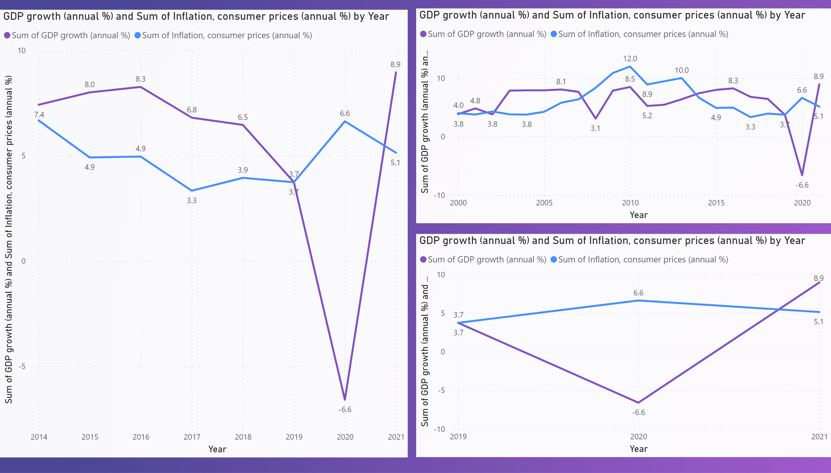
Annual GDP vs Inflation
Notes:
GDP growth (annual %) and Sum of Inflation, consumer prices (annual %) by Year
No alt text provided
GDP growth (annual %) and Sum of Inflation, consumer prices (annual %) by Year
No alt text provided
GDP growth (annual %) and Sum of Inflation, consumer prices (annual %) by Year
No alt text provided

Slide 5
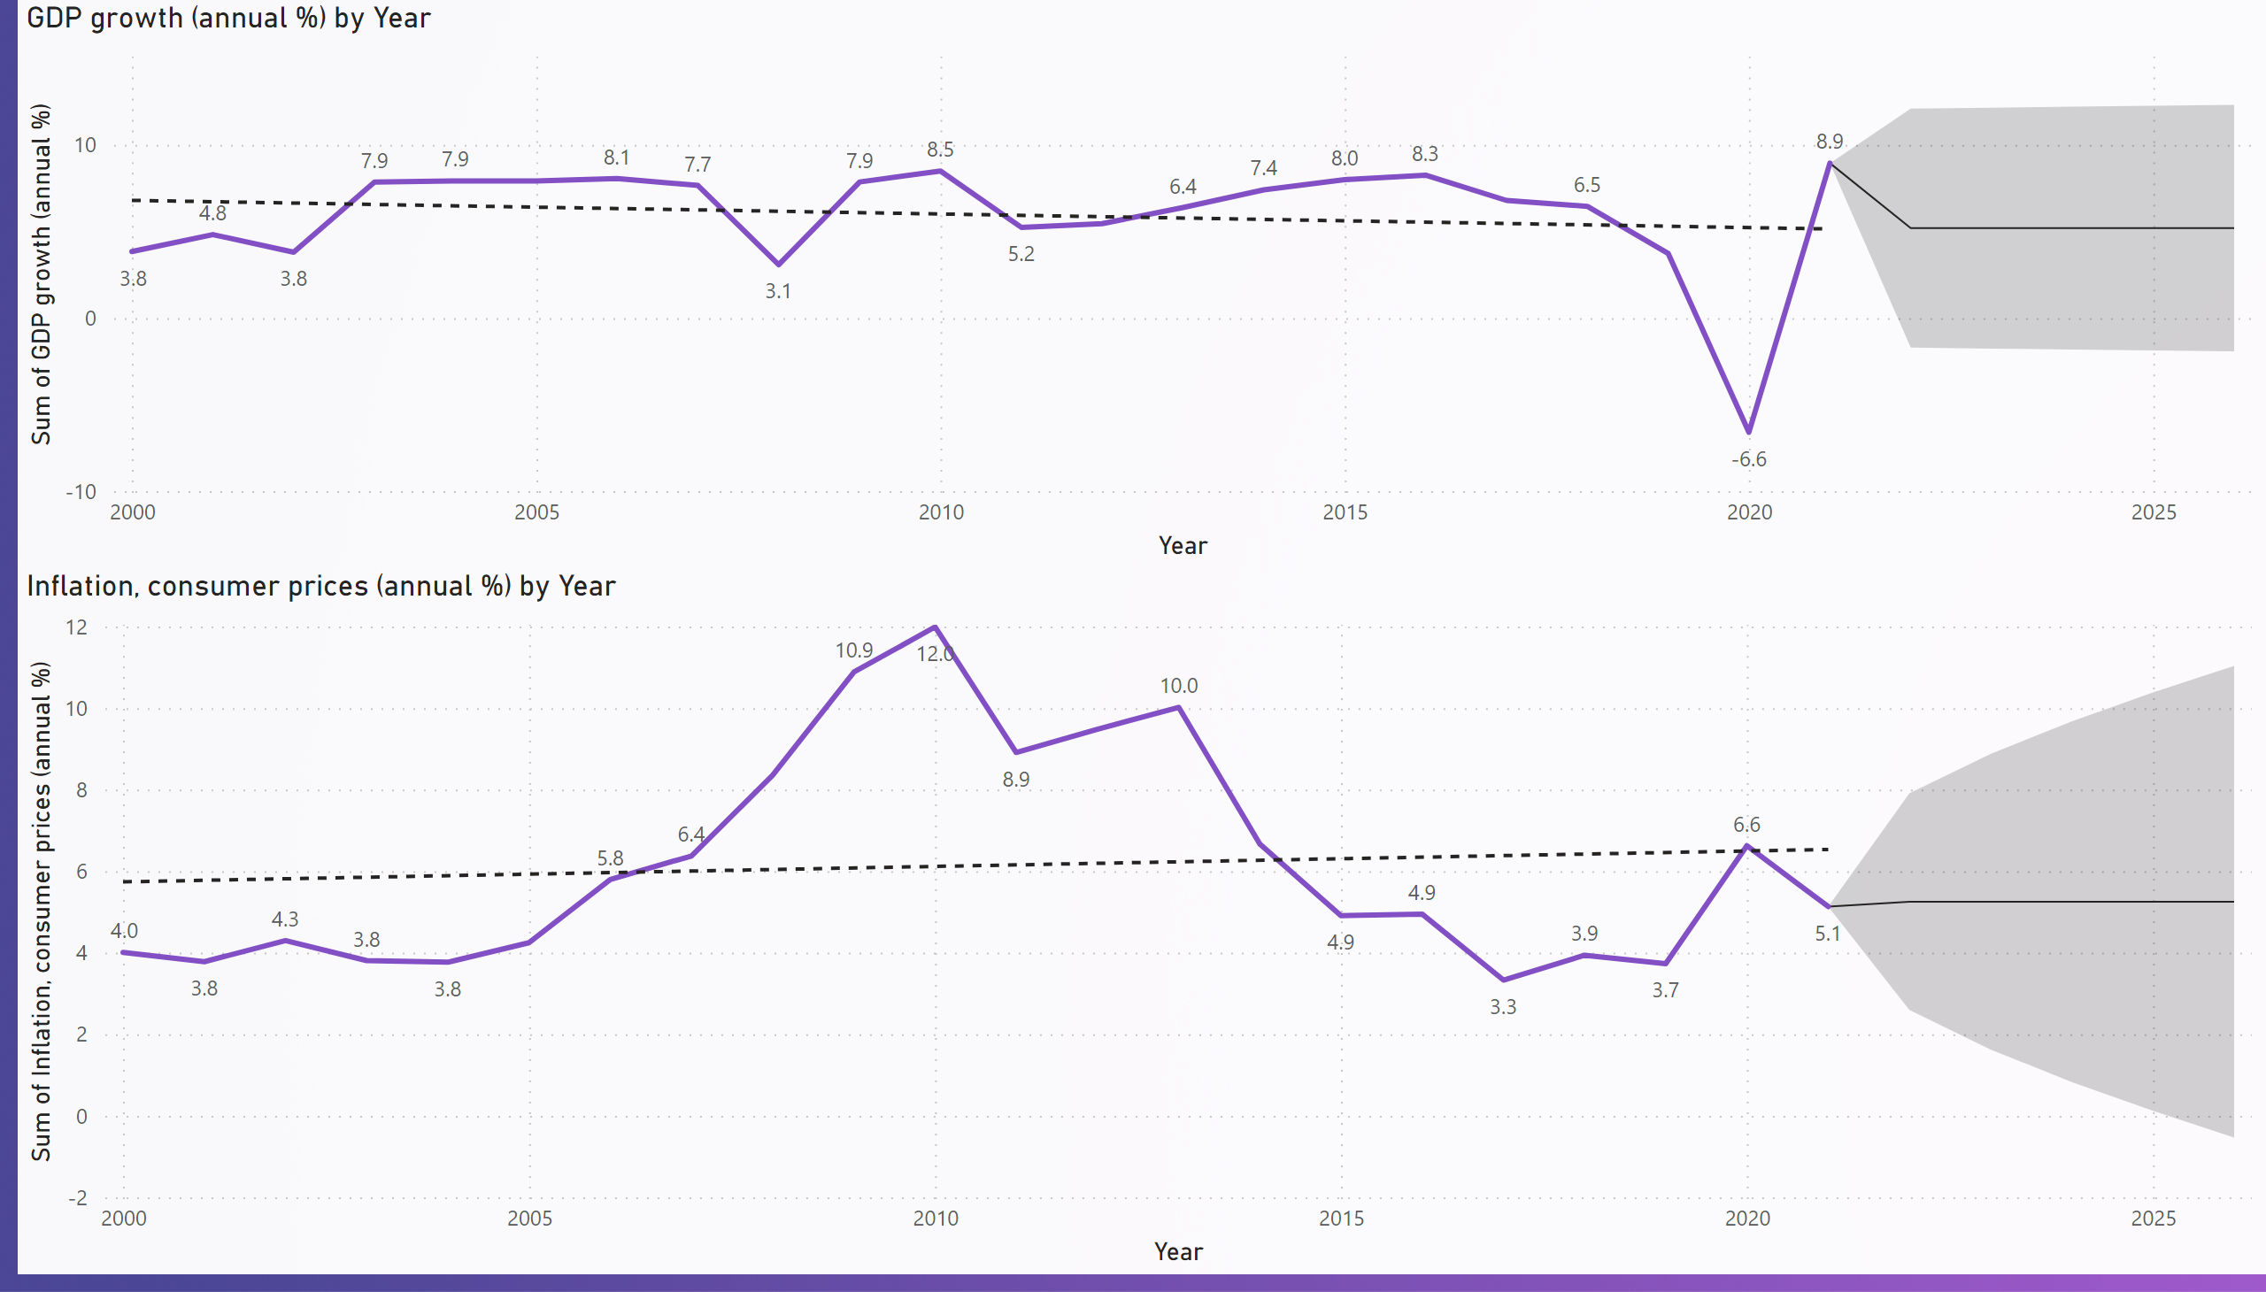
Forecost
Notes:
GDP growth (annual %) by Year
No alt text provided
Inflation, consumer prices (annual %) by Year
No alt text provided

Slide 6
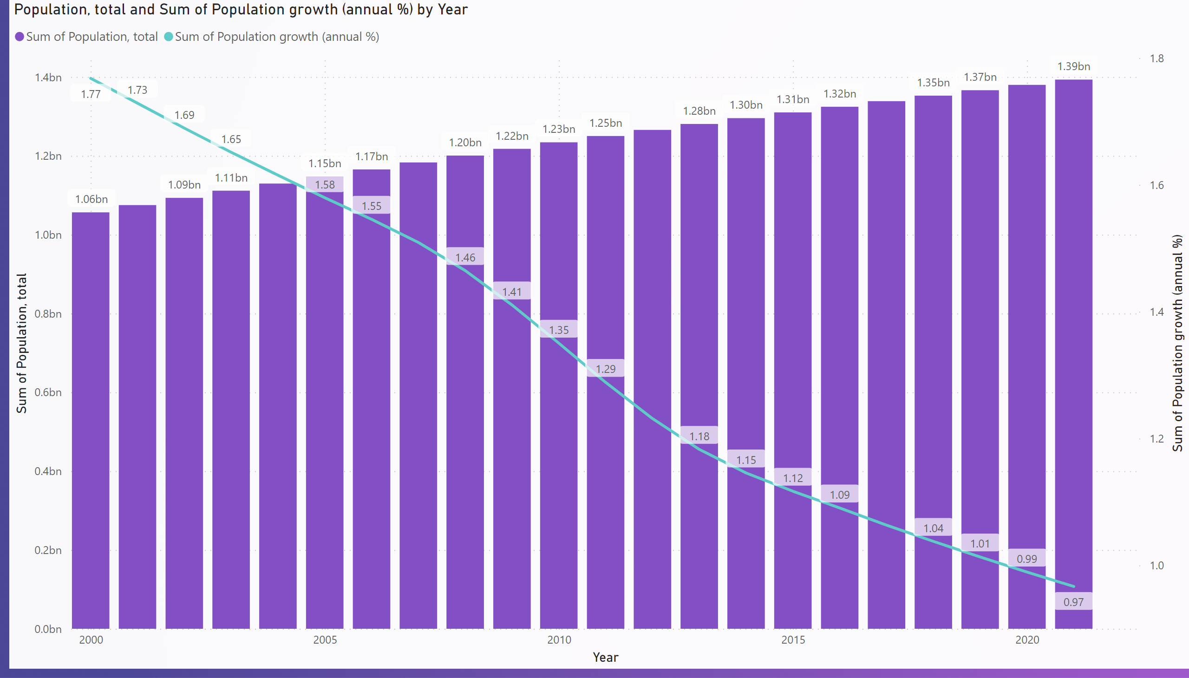
Populations
Notes:
Population, total and Sum of Population growth (annual %) by Year
No alt text provided

Slide 7
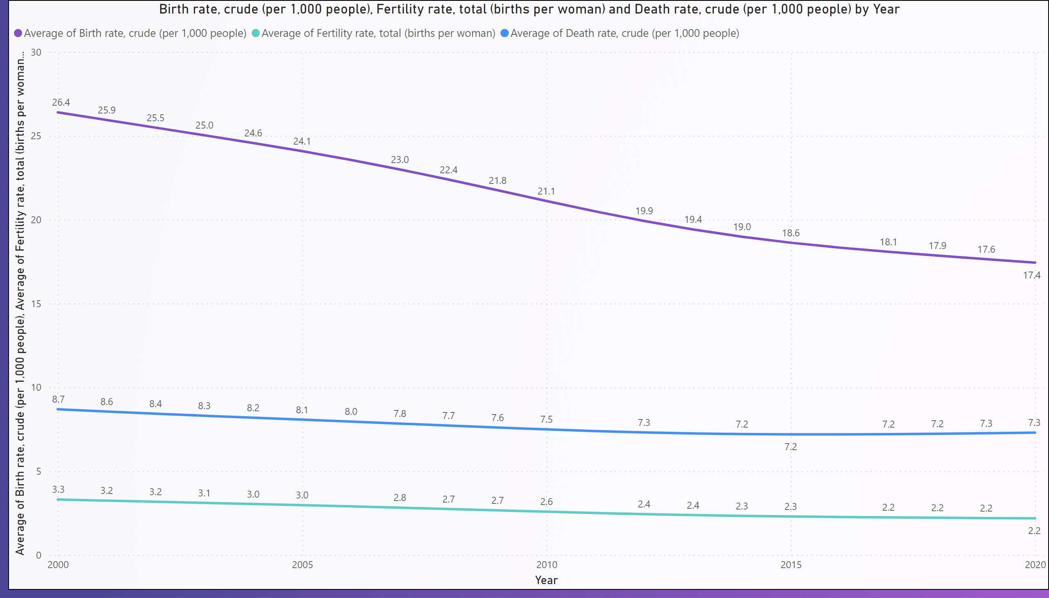
Death Birth & inf
Notes:
Birth rate, crude (per 1,000 people), Fertility rate, total (births per woman) and Death rate, crude (per 1,000 people) by Year
No alt text provided

Slide 8
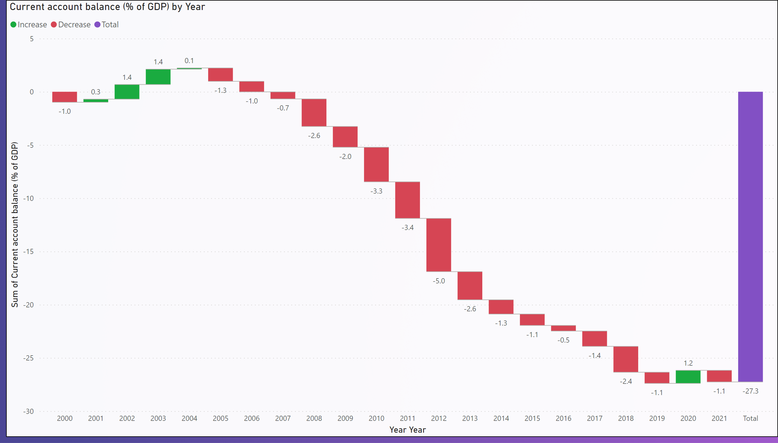
CAB
Notes:
Current account balance (% of GDP) by Year
No alt text provided

Slide 9
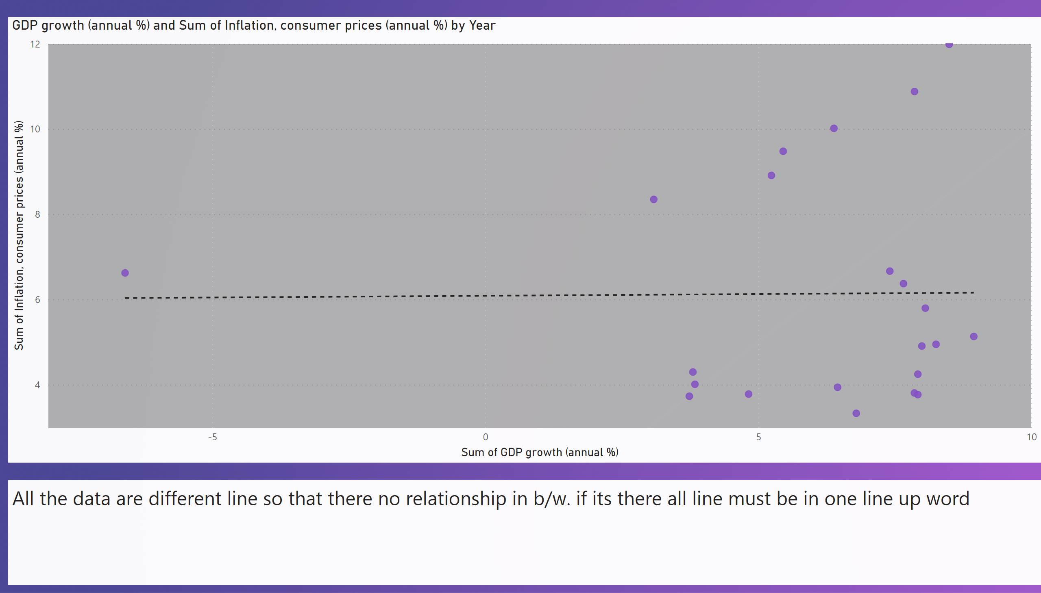
GDP growth vs Infelations
Notes:
GDP growth (annual %) and Sum of Inflation, consumer prices (annual %) by Year
No alt text provided
textbox
No alt text provided

Slide 10
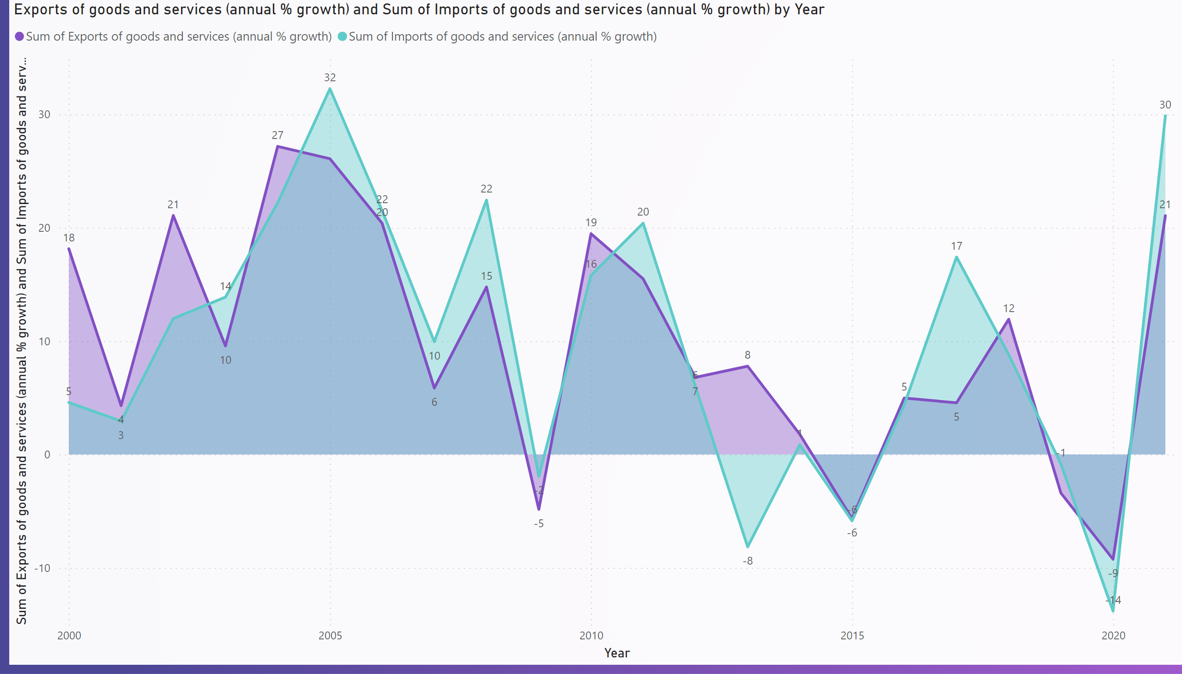
Export & Import
Notes:
Exports of goods and services (annual % growth) and Sum of Imports of goods and services (annual % growth) by Year
No alt text provided

Slide 11
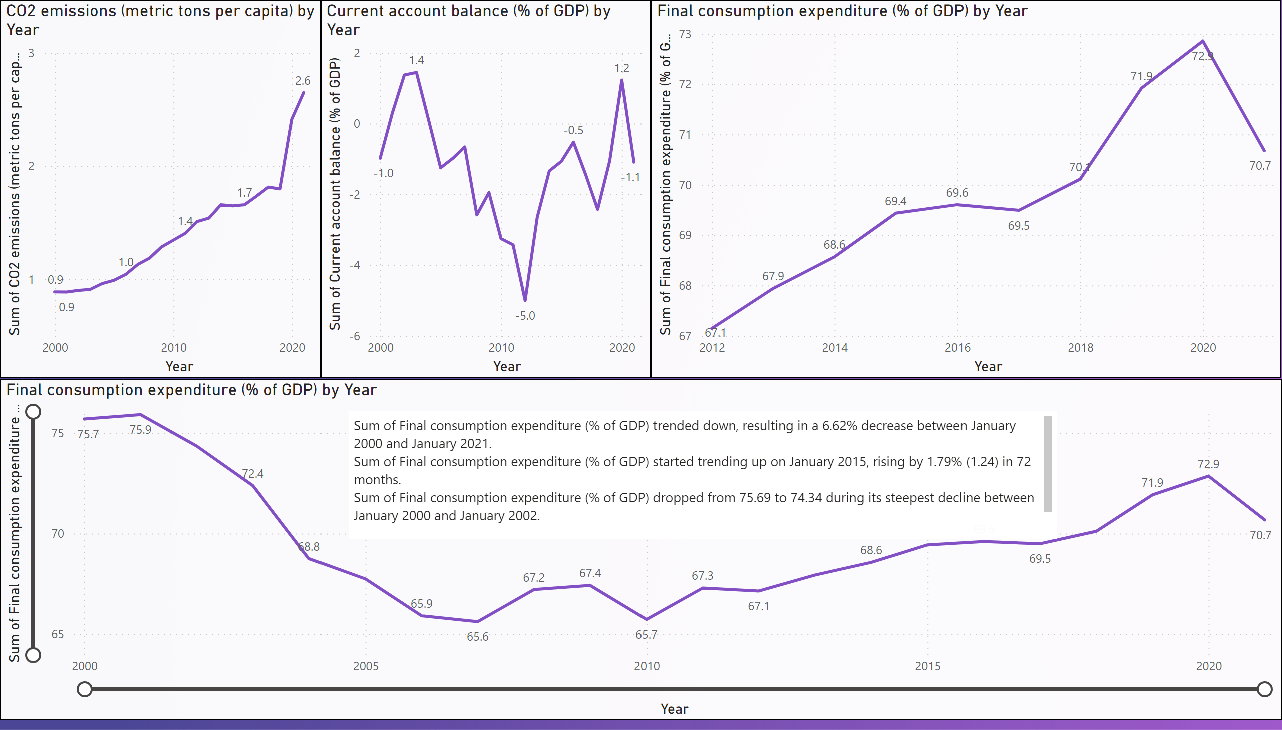
CO2
Notes:
Final consumption expenditure (% of GDP) by Year
No alt text provided
Final consumption expenditure (% of GDP) by Year
No alt text provided
CO2 emissions (metric tons per capita) by Year
No alt text provided
Current account balance (% of GDP) by Year
No alt text provided
textbox
No alt text provided

